Slide 1
AIRFIRE
Andre Lemos,
Fabio Ciconi and
Rodrigo Geronimo

Slide 2
Schedule
Game World and Story
Characters
Game Progression
Game
Future Features

Slide 3
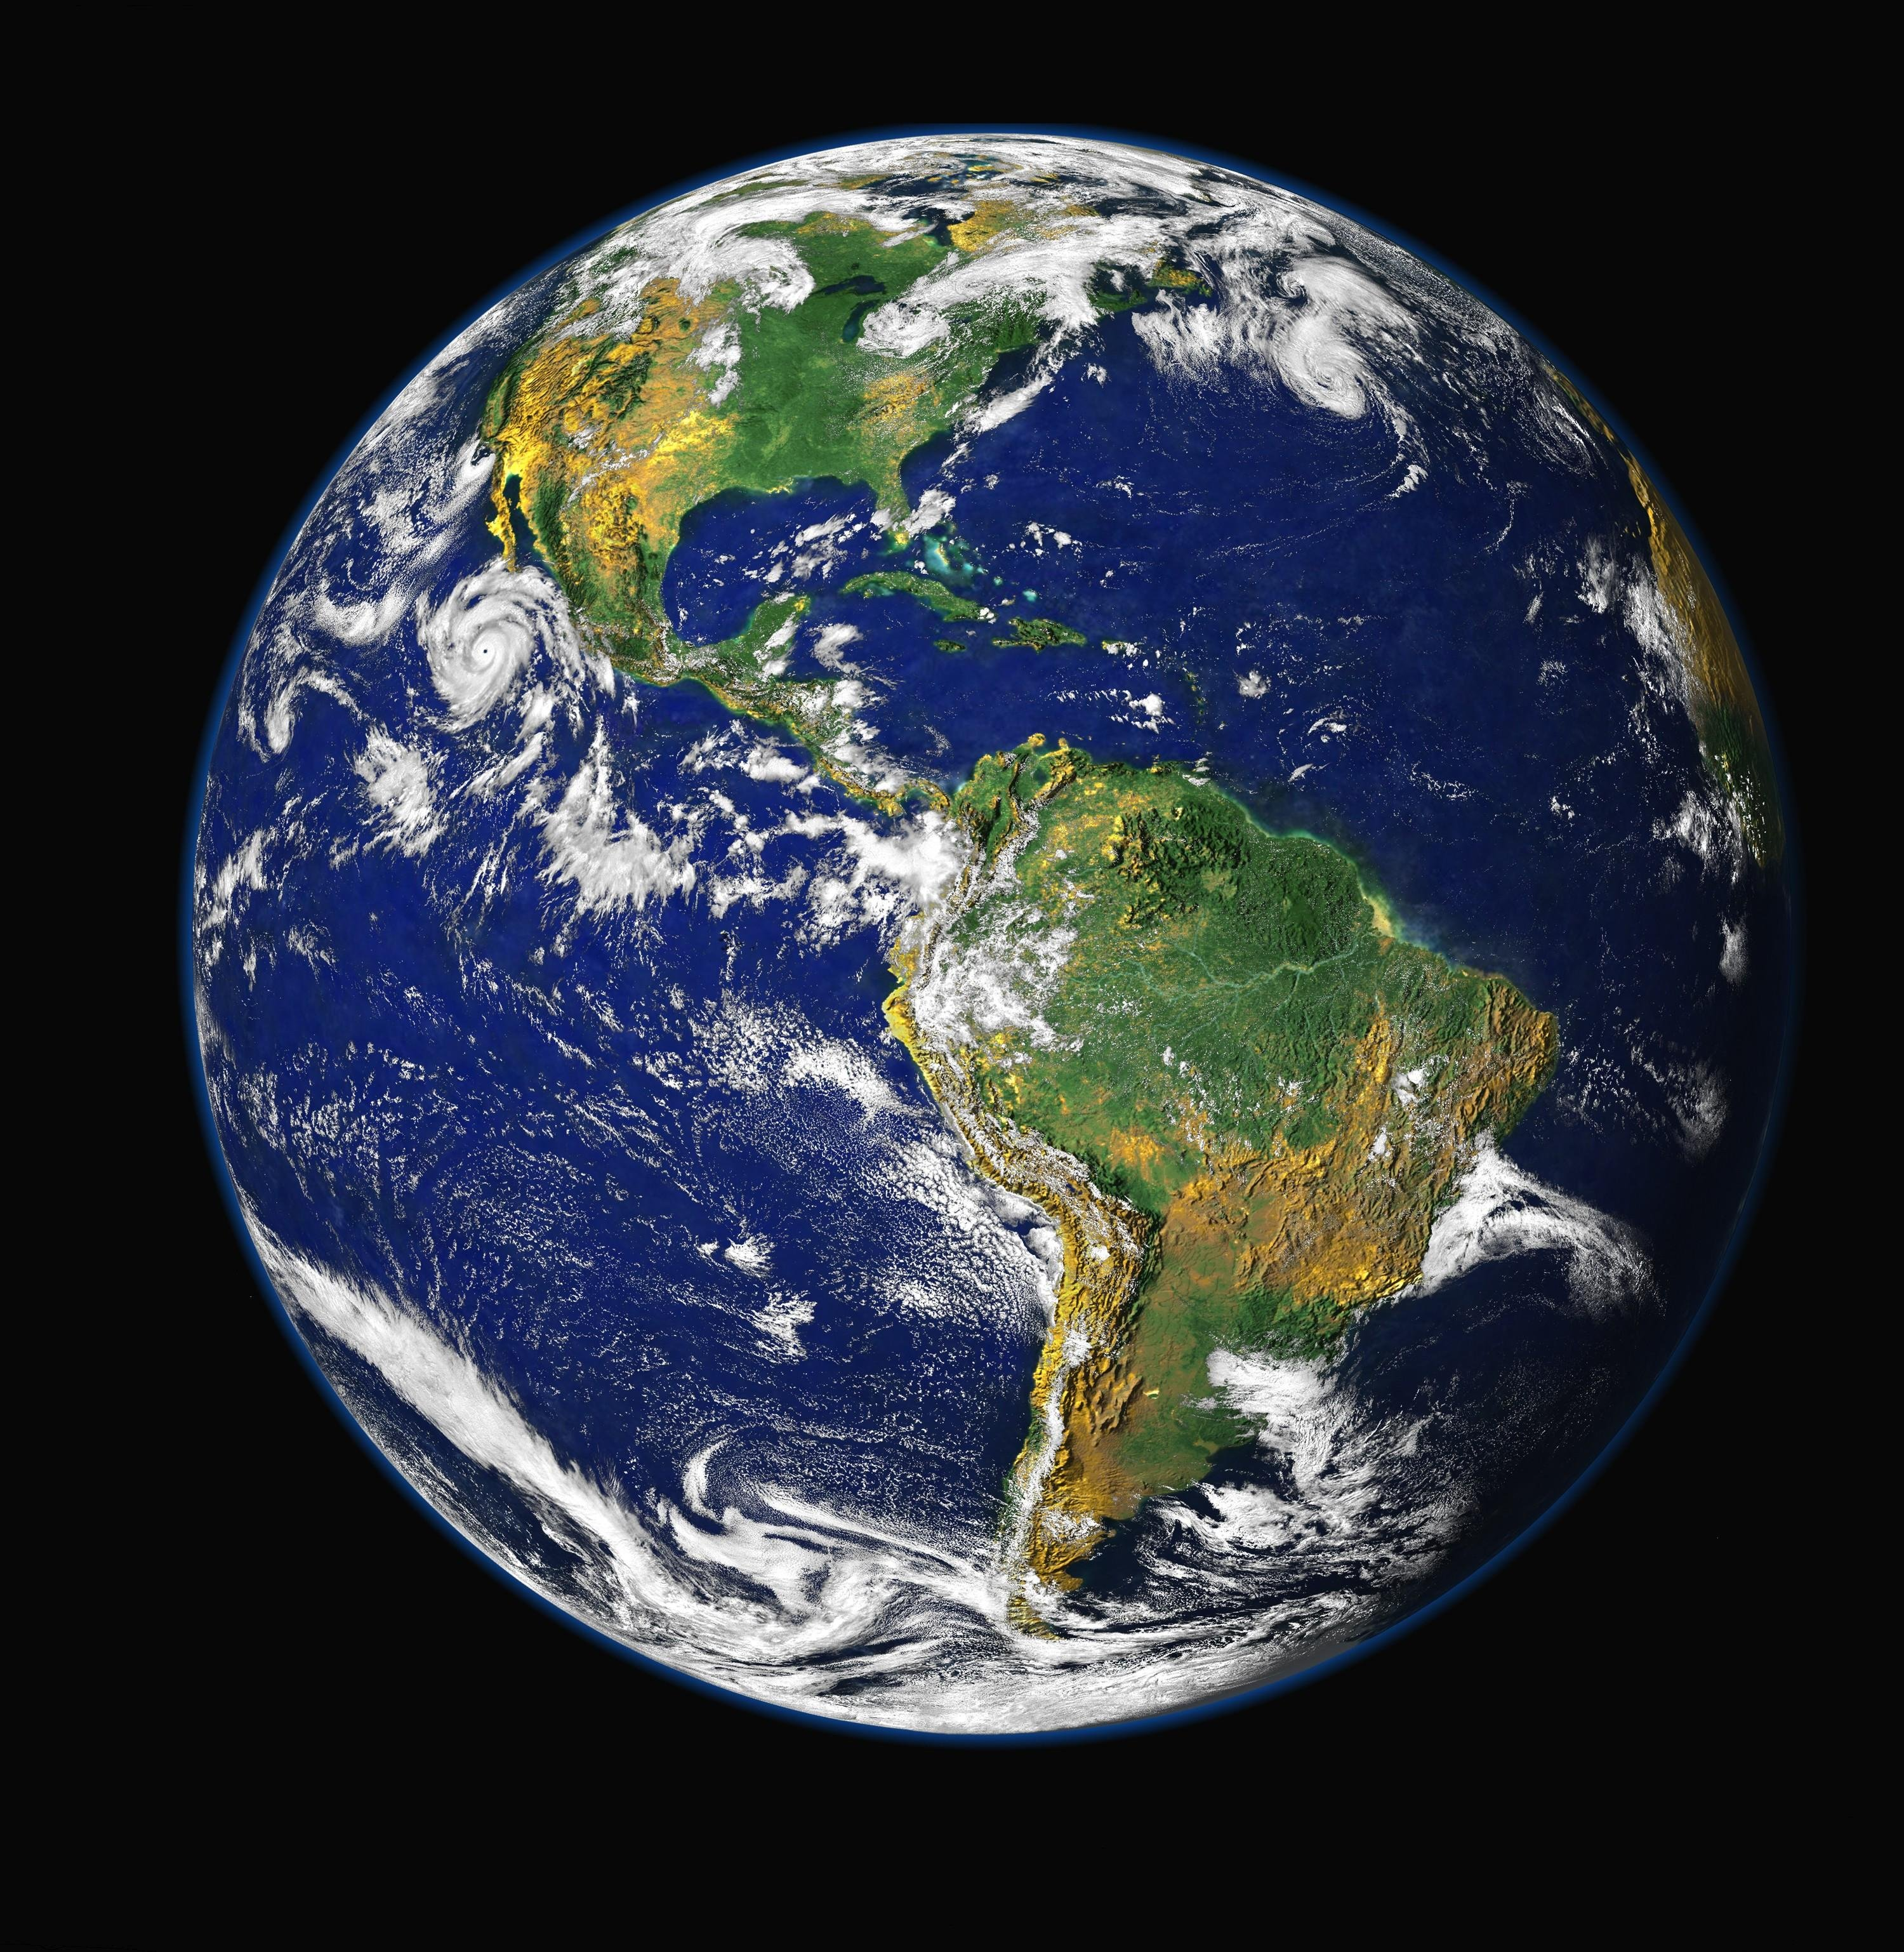
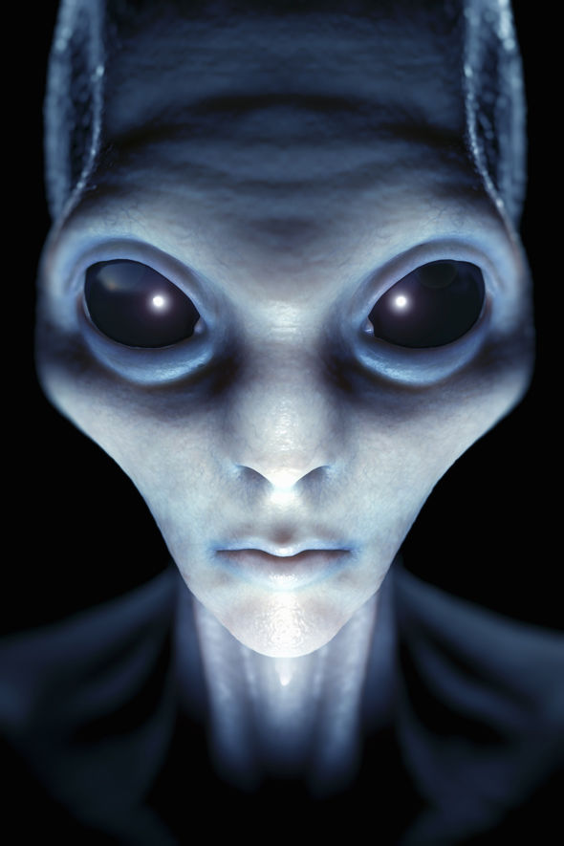
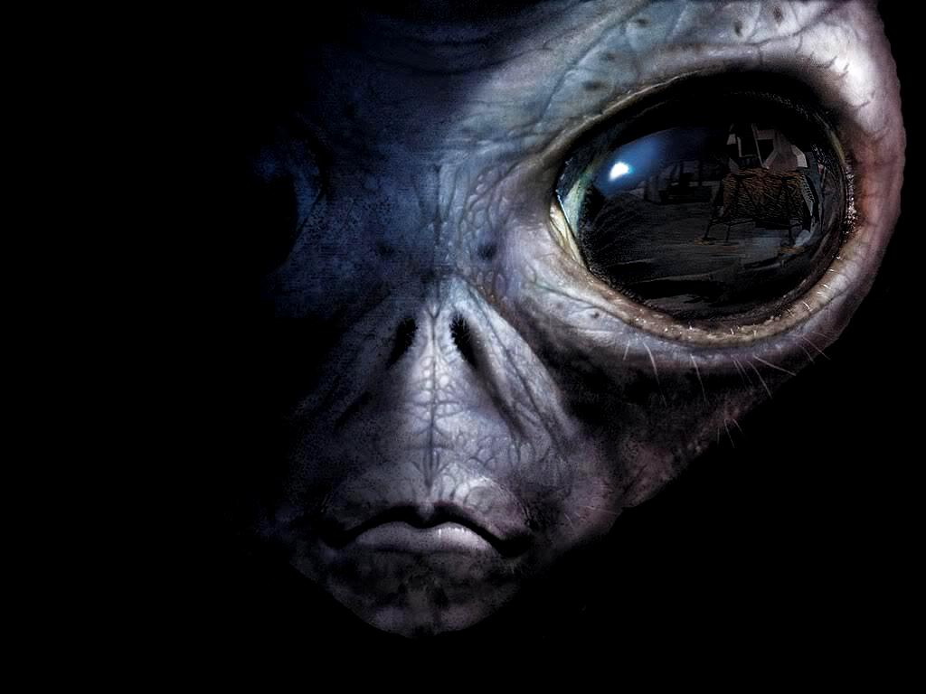
Game World
2100 - 83 years in the future
The humankind remains living on earth.
We are not alone in universe

Slide 4



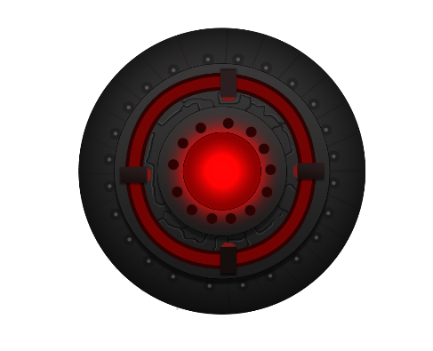
Characters
Hero AirFire007
Aliens spaceship
Asteroids
Mother alien space ship

Slide 5
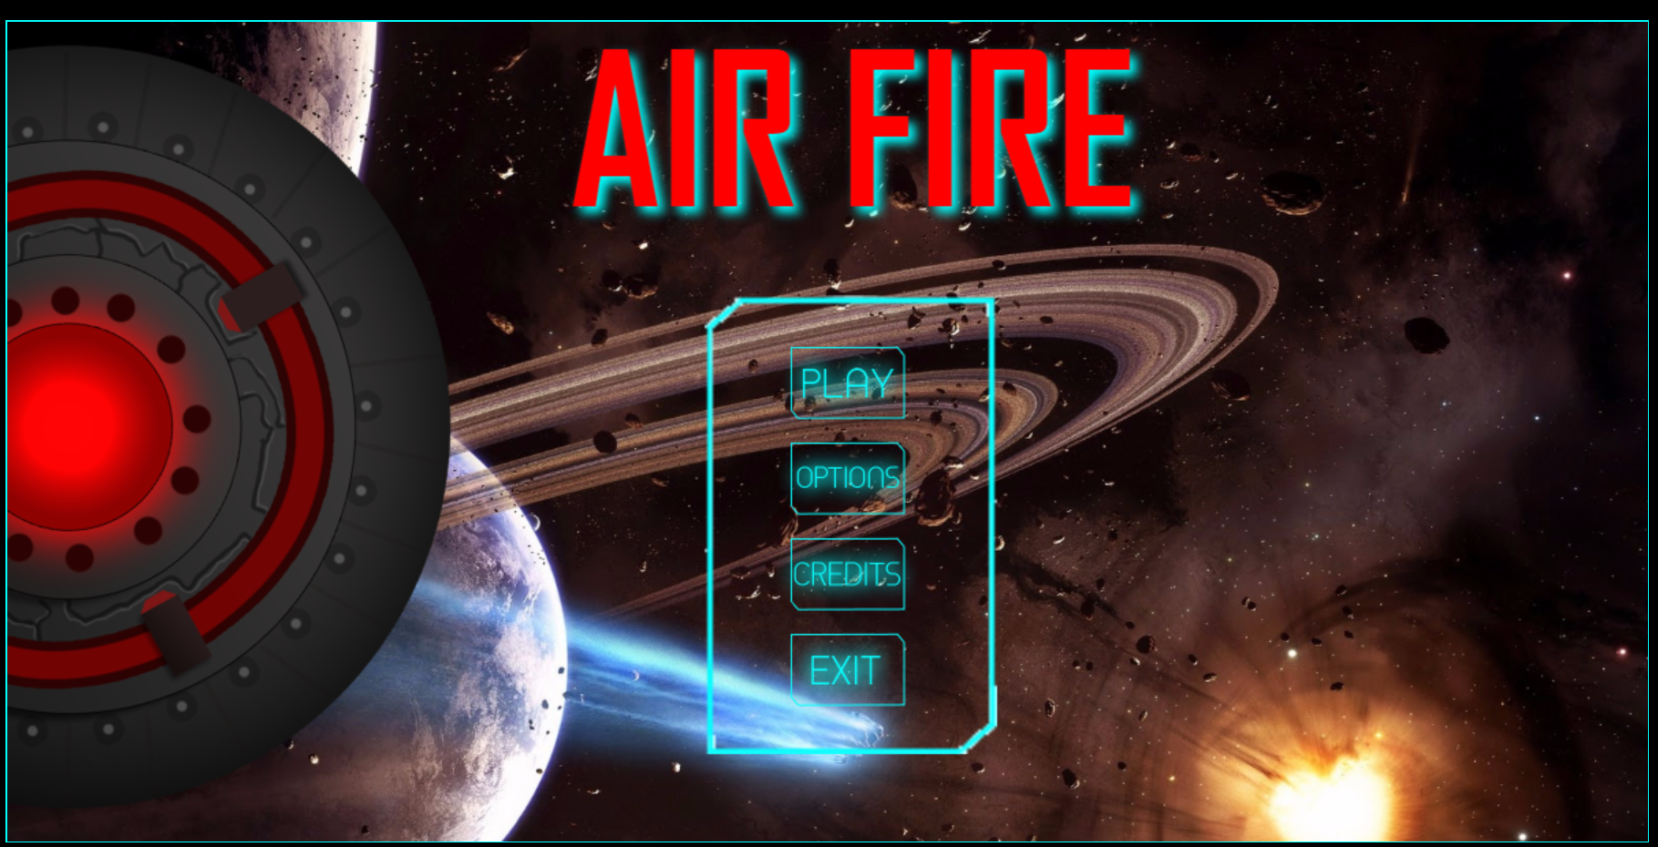
Game Menu

Slide 6
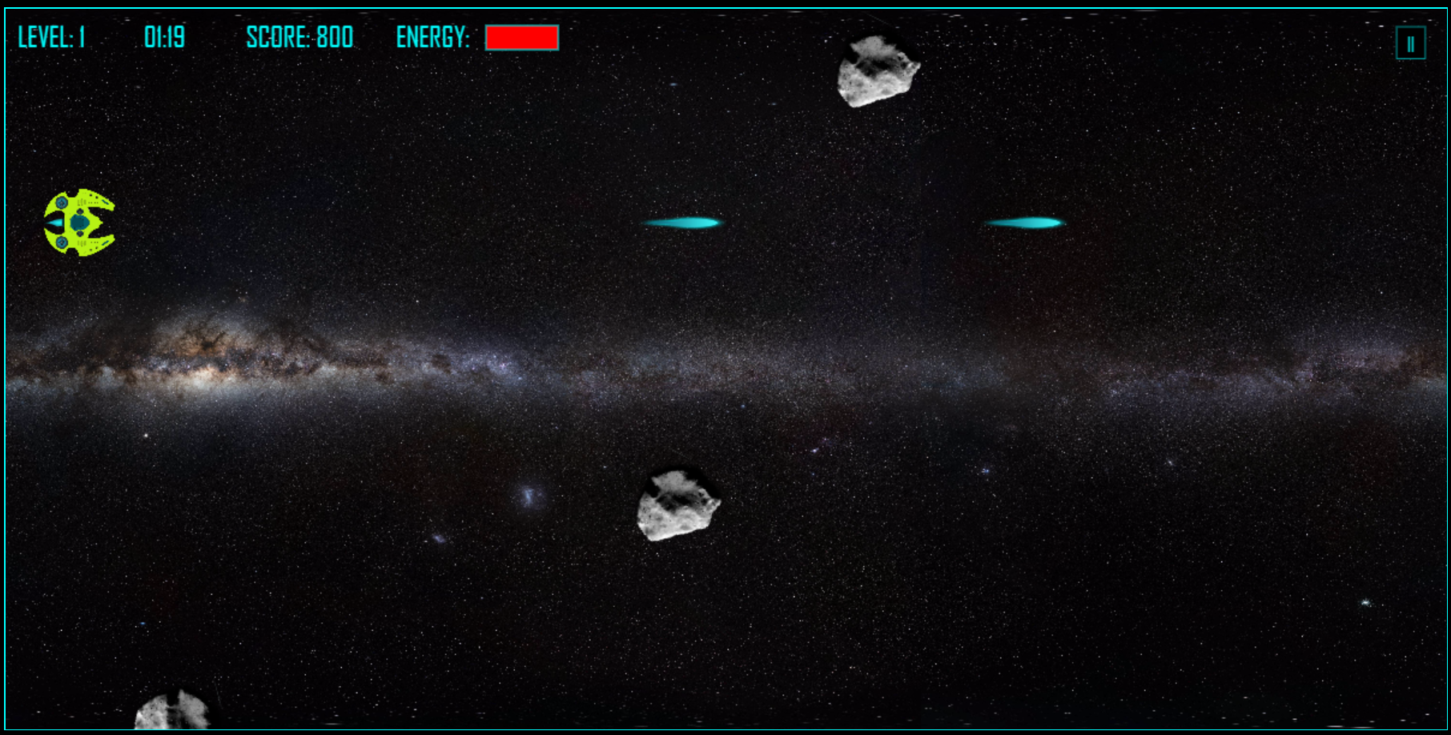
Level 1

Slide 7
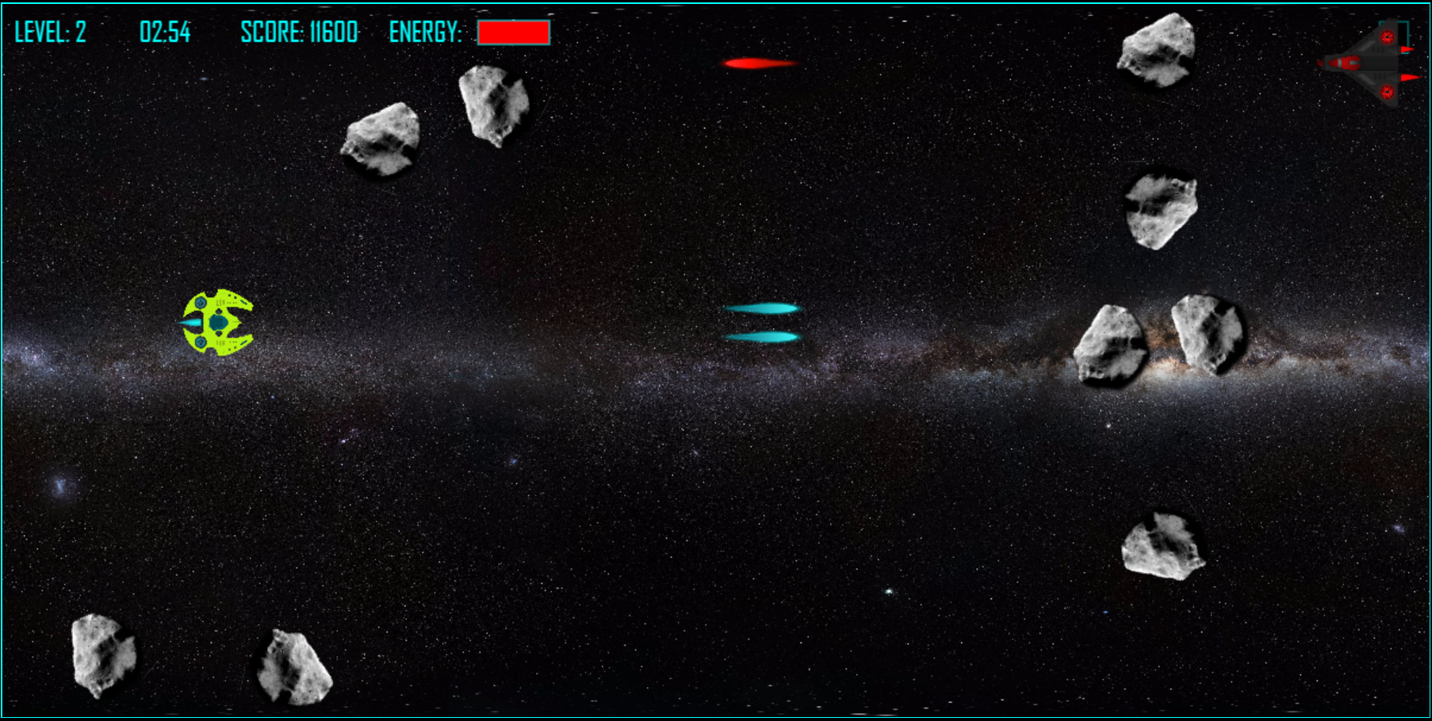
Level 2

Slide 8
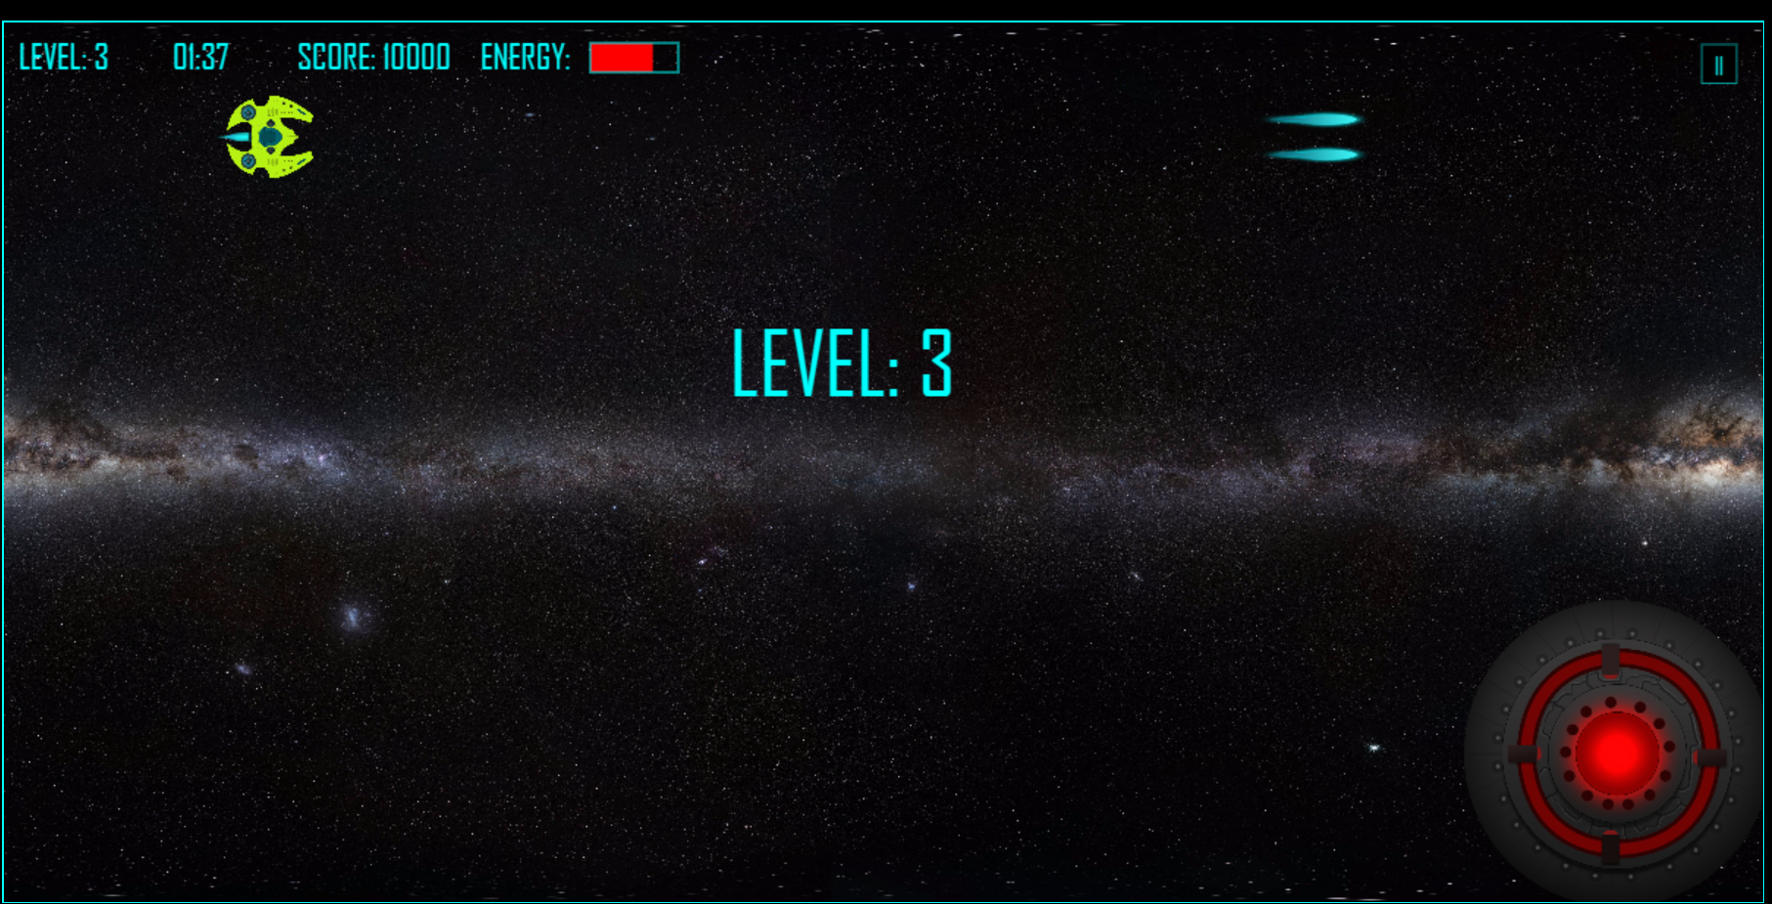
Level 3

Slide 9
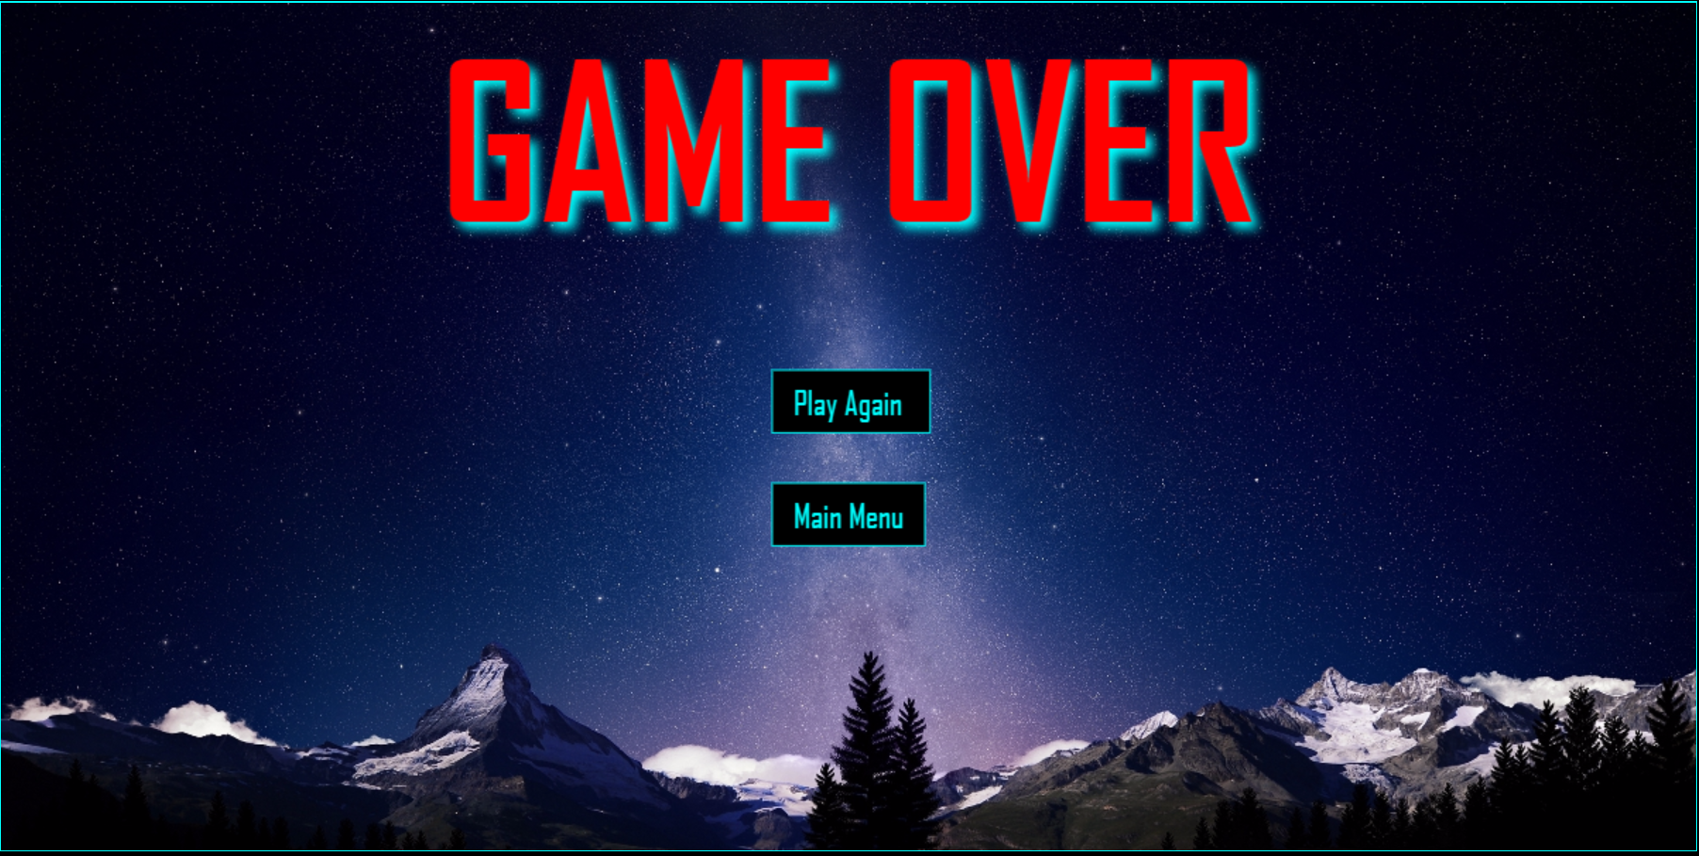
Game Over

Slide 10
Future Facture
Multiplayer Platform
New Stages
New Aliens
New Planets

